Slide 2
… RECOGNIZING HIM …

Slide 3
MATTHEW 21:10
» 10 † And when he was come into Jerusalem, all the city was moved, saying, Who is this?
» 11 † And the multitude said, “This is Jesus the prophet of Nazareth of Galilee.”

Slide 4
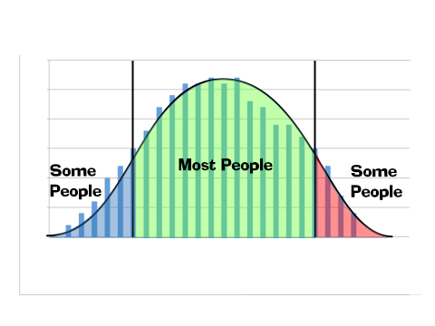

Slide 5
MATTHEW 21:10
» 10 † And when he (Jesus) was come into Jerusalem,
all the city was moved, saying, Who is this?
11 † And the multitude
said, “This is Jesus the
prophet of Nazareth of
Galilee.”
A Devil
A Good Man …Prophet
God
» 15 †
…the chief priests
and scribes ...
they were sore
displeased
MATT 16: 16
And Simon Peter
answered and said,
Thou art the
Christ, the Son
of the living God.
“a prophet mighty in deed
and word before God
and all the people:”
MATT 1:23
…Emmanuel, which
being interpreted is,
God with us.
They called
HIM “Beelzebub”
The Devil
68

Slide 6
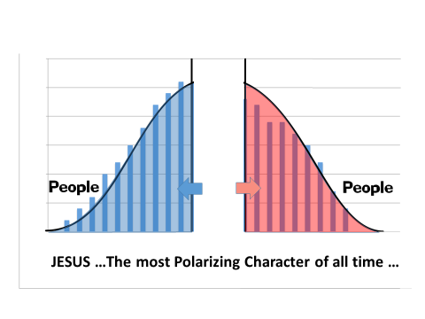

Slide 7
MATTHEW 21:10
» 10 † And when he (Jesus) was come into Jerusalem,
all the city was moved, saying, Who is this?
11 † And the multitude
said, “This is Jesus the
prophet of Nazareth of
Galilee.”
A Devil
A Good Man …Prophet
God
» 15 †
…the chief priests
and scribes ...
they were sore
displeased
MATT 16: 16
And Simon Peter
answered and said,
Thou art the
Christ, the Son
of the living God.
“a prophet mighty in deed
and word before God
and all the people:”
MATT 1:23
…Emmanuel, which
being interpreted is,
God with us.
They called
HIM “Beelzebub”
The Devil
68

Slide 8
MATTHEW 21:10
» 10 † And when he (Jesus) was come into Jerusalem,
all the city was moved, saying, Who is this?
11 † And the multitude
said, “This is Jesus the
prophet of Nazareth of
Galilee.”
A Devil
A Good Man …Prophet
God
» 15 †
…the chief priests
and scribes ...
they were sore
displeased
Jesus
is a good man
who loves everybody …
MATT 16: 16
And Simon Peter
answered and said,
Thou art the
Christ, the Son
of the living God.
“a prophet mighty in deed
and word before God
and all the people:”
MATT 1:23
…Emmanuel, which
being interpreted is,
God with us.
They called
HIM “Beelzebub”
The Devil
68

Slide 9
St Paul’s Message … The Revealed WORD of The Hour …
ACTS 19:8
» 8 † ¶ And he went into the synagogue, and spake boldly for the space of three months, disputing and persuading the things concerning the kingdom of God.
» 9 † But when divers were hardened, and believed not, but spake evil of that way before the multitude, he departed from them, and separated the disciples, disputing daily in the school of one Tyrannus.
» 10 † And this continued by the space of two years; so that all they which dwelt in Asia heard the word of the Lord Jesus, both Jews and Greeks.
» 11 † And God wrought special miracles by the hands of Paul:
» 12 † So that from his body were brought unto the sick handkerchiefs or aprons, and the diseases departed from them, and the evil spirits went out of them.
I THESSALONIANS 2:13
For this cause also thank we God without ceasing, because, when ye received the word of God which ye heard of us, ye received it not as the word of men, but as it is in truth, the word of God,
A Devil
A Good Man …Prophet
God
ACTS 26:24
And as he thus spake for himself, Festus said with a loud voice, Paul, thou art beside thyself; much learning doth make thee mad.
68

Slide 10
Bro Branham’s Message … The Revealed WORD of The Hour …
BUT The Elect … SEE JESUS CHRIST
HIMSELF …And hear HIM Calling out HIS Bride
A Devil
A Good Man …Prophet
God
Many websites and Theologians profess the Message to be false teaching … The Devil at work…
Many who saw the
miracles, and those who
were healed and
converted in the Ministry
just see A Good Man …
… A Godly Man …
… A Prophet !
68

Slide 11
63-0707M THE.INDICTMENT_ JEFFERSONVILLE.IN V-3 N-19 SUNDAY_
208 … Why'd they crucify Him? Why? Why? Because they didn't recognize Who He was.
209 That's the same thing today.
The preachers, and people of this days, and our modern teachers, has so indocumated the people to believe that This is "witchcraft, or the devil, or a mental telepathy, or some hoax, or some kind of a trick,"
until the people don't recognize that it's the vindication of God's Word for this day.

Slide 12
THE THREE-FOLD
PURPOSE OF GOD

Slide 13
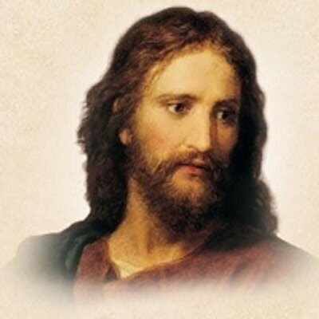
1. First, to express Hisself completely,
God in Christ.

Slide 14
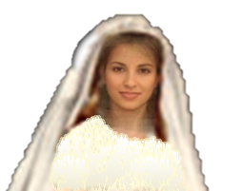
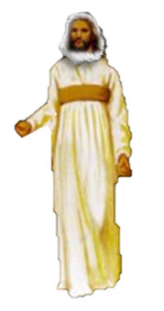
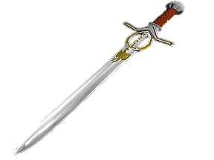
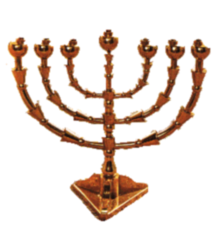
2. Second, to have the pre-eminence
in His Bride

Slide 15
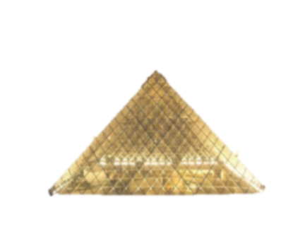
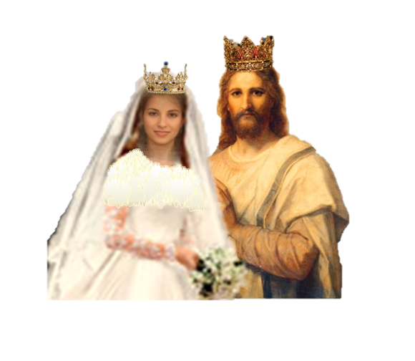
3. Thirdly, to restore the Kingdom
63-0728
CHRIST.IS.THE.MYSTERY.
OF.GOD.REVEALED_
JEFFERSONVILLE.IN
V-3 N-7 SUNDAY_ 154

Slide 16
Complex Mathematical Problem …
2
But if the Mathematician
Who Wrote The Question … comes and→
Gives The Answer
In the Answer Book
(3x +8)
49 =
2
x
2
(3x +8)
49 =
Solve for ‘x’
2
x
3x +8
???
7 =
No Longer a Question … The Problem Has been Solved
x
7x =
3x +8
7x – 3x =
8
4x =
8
x =
2

Slide 17
Complex Mathematical Problem …
But if the Mathematician
Who Wrote The Question … comes and→
Gives The Answer
In the Answer Book
No Longer a Question … The Problem Has been Solved
Doctrinal Questions From The Bible …
When GOD, Who Wrote The Bible ...
Comes down and Opens the Seven Seals … and→
Reveals The Answers
To and Through His Prophet
No Longer a Question … The Problem Has been Solved

Slide 18
The Godhead ? JESUS is Jehovah
Baptism ? THE “LORD JESUS CHRIST“ is The NAME
of The Father / Son / Holy Ghost
Evidence of The Holy Ghost ? Receive Whom HE has Sent
The Seven Church Ages ? The Ages & Messengers Identified
The Purpose of The Message ? The RAPTURE of The BRIDE
Worldliness condemned and …
Organized Religion exposed as ‘The Man Of Sin’
The Seven Seals ? Opened … & The Mysteries Revealed
The Bride now to Eat the little Book = His Life now in Her
The Future Home ? Beyond the curtain of Time Revealed

Slide 19
JESUS was => The ALPHA coming of Christ (1st Coming)
&
REV 10:1 is => The OMEGA coming of Christ (2ndAdvent)

Slide 20
65-0217 A.MAN.RUNNING.FROM.THE.PRESENCE.OF.THE.LORD_ JEFFERSONVILLE.IN V-5 N-8 WEDNESDAY_
« 60 † And when you see then, in this day now, when the Word of God has made these promises of things that we see happening now, then we've got the responsibility to either face up to It or get away from It. You have... You just can't stay neutral. You've got to do something about It. ... Some move has got to be made.
You can't come in that church door and go out the same person you come in. You're either further away, or closer to God, every time you come in or go out there.

Slide 21
JESUS’ BRIDE …
BUT The Elect … is MRS JESUS CHRIST …part of GOD HIMSELF !
A Devil
A Good Man …Prophet
God
Most people see your good works which the Life of Christ in you produces, and will say …”They are GOOD People “…
Some think SHE’s possessed of a Devil
68

