Slide 1

THE QUEEN AND HER FUTURE
SUBJECTS
THE EVIDENCE OF ADOPTION.

Slide 2
YES, YOU ARE YOUR BROTHERS KEEPER.
GENESIS 4:9
» 9 † ¶ And the LORD said unto Cain, Where is Abel thy brother? And he said, I know not: Am I my brother's keeper?

Slide 3
PROVERBS 18:21
» 21 † ¶ Death and life are in the power of the tongue: and they that love it shall eat the fruit thereof.

Slide 4
MATTHEW 5:14
» 14 † Ye are the light of the world. A city that is set on an hill cannot be hid.
» 15 † Neither do men light a candle, and put it under a bushel, but on a candlestick; and it giveth light unto all that are in the house.
» 16 † Let your light so shine before men, that they may see your good works, and glorify your Father which is in heaven.

Slide 5
JUDE 1:18
» 18 † How that they told you there should be mockers in the last time, who should walk after their own ungodly lusts.
JUDE 1:21
» 21 † Keep yourselves in the love of God, looking for the mercy of our Lord Jesus Christ unto eternal life.
» 22 † And of some have compassion, making a difference:
» 23 † And others save with fear, pulling them out of the fire; hating even the garment spotted by the flesh.
ENDTIME SCRIPTURES FOR AND ENDTIME CONDITION.

Slide 6
JUDE 1:18
» 18 † How that they told you there should be mockers in the last time, who should walk after their own ungodly lusts.
II PETER 3:3
» 3 † ¶ Knowing this first, that there shall come in the last days scoffers, walking after their own lusts,
» 4 † And saying, Where is the promise of his coming? for since the fathers fell asleep, all things continue as they were from the beginning of the creation.

Slide 7
REVELATION 6:9
9 ¶ And when he had opened the fifth seal, I saw under the altar the souls of them that were slain for the word of God, and for the testimony which they held:

Slide 8
“SOME” OF OUR REPRESENTATIVE CHARACTERS
RUTH
ESTHER
HANNAH
SARAH
REBEKAH
RACHEL
MARY
etc

Slide 9
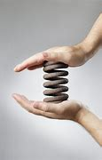
THEIR EXPERIENCES
COMPRESS INTO
AN INDIVIDUAL
OF THE ENDTIME
BRIDE
RUTH
ESTHER
HANNAH
RACHEL
REBEKAH
RAHAB
SARAH

Slide 10
THEME:
KNOWING WHO YOU ARE
AND WHAT YOU ARE
TO OTHERS..

Slide 11
64-0629 THE.MIGHTY.GOD.UNVEILED.BEFORE.US_ PHILADELPHIA.PA V-3 N-22
« 43 † I was reading a story, some years ago. And in this story, it said a great, noble king... I forget the name of him, just now. I wasn't thinking about speaking of the story. It, perhaps fiction, but it leads us to a point that gives us a background on what we want to say. This king, he was such a noble king, and such a great lover of his subjects, till, one day, before his--his guard and his royalty, he said, "Today, you see me for your last time, for many years."
44 And his guard and his nobles said to him, "Good king, why do you say that? Are you going to a foreign country, somewhere, and become an alien?"
45 He said, "No. I'm staying right here. Well," said, "I'm going out amongst my subjects. I'm going to become a peasant. I'm going to cut wood with the wood chopper. I'm going to--to till the ground with the toiler. I am going to prune the vines with those who prune the vines. I'm going to be one of them, in order to get a better acquainted with what they are doing. And I love them. And I want to be more acquainted with them, personally. They won't know me. But, yet, I want to be acquainted with them, in that way."

Slide 12
Continued…
64-0629 THE.MIGHTY.GOD.UNVEILED.BEFORE.US_ PHILADELPHIA.PA V-3 N-22
« 46 † And the next morning, when his delegates, all of his people seen him, or the ones was in the palace, take off his crown and lay it down upon the seat, the throne; and take his robe off, and put on peasant's clothes, walk out amongst common people.
Now, in that little story, we find out then about God.
47 They said to the king, said, "King, we want you. We love you. We--we want you to remain king." But he wanted become one of them, to know them better, that they would know him better, really what he was. It would display to them what he really was.

Slide 13
ROYAL SEED AMONGST SATANS WORLD IN THE LAST DAYS.
65-0219 THIS.DAY.THIS.SCRIPTURE.IS.FULFILLED_
151 Now, but in this day there is to come a super, Royal Seed of Abraham. That's exactly what It'd be, would be a Royal Bride to the Royal, promised Son. As I spoke last night, it won't be a natural seed, it'll be a spiritual Seed. There is to be a spiritual Bride raise up, which will be the Royal Seed of the royal Faith of Abraham's Royal Son. She is to come on the scene in the last days, and the time and the place is a promise that's given to Her.

Slide 14
FAITH IS A LONG-RANGE VISION.
63-0714M WHY.CRY.SPEAK_ JEFFERSONVILLE.IN V-2 N-26 SUNDAY_
« 161 † For, you see, faith sees what God wants done. Oh, I hope this goes in. Faith doesn't look at the present time. Faith doesn't see this here. Faith looks to see what God wants, and it works accordingly. That's what faith does. It sees what God wants, and what God wants done, and faith operates through that.
162 Faith is a long-range vision. It don't lower its sights. It holds to the target. Amen! Any good shooter knows that. See? That, it's long range. It's a--it's a telescope. It's a binocular, that you don't look around here. You don't use binoculars to look to see what time it is; see, you don't use that. But you use binoculars to look a way off.

Slide 15
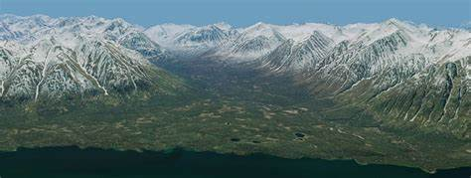
FAITH HAS LONG RANGE VISION…
IT SEES THE END…THE ACHIEVEMENT… AND THE THINGS INBETWEEN ARE TO LEARN FROM…
RULERSHIP
OBSTACLES ALONG THE WAY FOR CHARACTER BUILDING
BEFORE YOU GET THERE.
(critical spirits… deceiving spirits… forces of opposition)

Slide 16
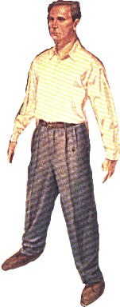
THE ROYAL SEED WITHIN
BODY
A CITY
A TEMPLE
A PRIEST
A VESSEL
A STONE
AN OFFERER
A MERCY SEAT
A TREE OF LIFE
SEE
SPIRIT
HEAR
MEMORY
CONSCIENCE
SOUL
I’LL MEET YOU IN HERE
TASTE
AFFECTION
FEEL
REASONING
IMAGINATION
SMELL
THE SOUL BY A NEW BIRTH CONTROLS THE BODY
AND SPIRIT TO EXPRESS WHERE THE GLORY OF GOD IS.

Slide 17
YOU ETERNAL IDENTITY
KEEPS UNFOLDING

Slide 18
REVELATION 6:9
9 ¶ And when he had opened the fifth seal, I saw under the altar the souls of them that were slain for the word of God, and for the testimony which they held:

Slide 19
JOHN THE EAGLE TO THE EAGLE PEOPLE
JOHN 7:24
» 24 † Judge not according to the appearance, but judge righteous judgment.

Slide 20
THE ENDTIME SPIRIT SCOFFING AT THE
MINISTRY OF THE “SON OF MAN”.
53-0614A EARNESTLY.CONTENDING.FOR.THE.FAITH.THAT.WAS.ONCE.DELIVERED.TO.THE.
« E-24 † Notice, let's get back to Cain again, and get some of the faith in the beginning. Watch those spirits, how they begin to move. It's the spirit of anything that does the work of it anyhow. The people have to be in this kind of a spirit to bring the latter days. The people's in the spirit of the latter days. The nations are in the spirit of the end time.
They got atomic weapons, hydrogen weapons, all kinds of things, because it's the spirit of the day. The people are in the spirit of the end time. The Church is moving together under the power and the impact of the Holy Spirit. And the world's running out yonder, and making fun, scoffing, laughing, and they living like the devil every day. It's in the spirit of the thing.

Slide 21
II PETER 3:3
» 3 † ¶ Knowing this first, that there shall come in the last days scoffers, walking after their own lusts,
» 4 † And saying, Where is the promise of his coming? for since the fathers fell asleep, all things continue as they were from the beginning of the creation.

Slide 22
SPOTS OF LIGHT
63-0113E PERSEVERANCE_ PHOENIX.AZ SUNDAY_
16 How they've taken just the desert and has converted it into a--a living quarters! Today we were riding up around on the head of the Camelback, lovely homes up there, almost like you're entering paradise. And then it would be beautiful, but sin is here everywhere: whiskey joints, immorality, just everything that's wrong, all kind of devices, and traps of the enemy, to trap human souls.
My wife said, "Then why are you here, Billy?"
17 I said, "Honey, it's black. But, you know, there is, all through that darkness down there, there's little spots of Light. That's God's chosen. And I'm here to put my shoulder with theirs, put my heart with theirs, my voice with theirs, and cry out against the darkness."

Slide 23

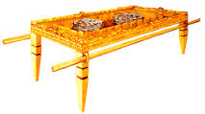



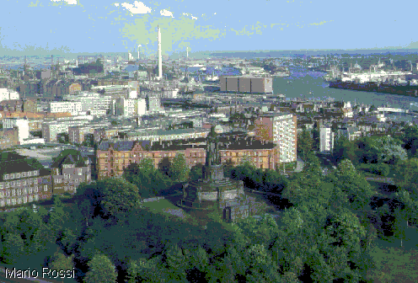


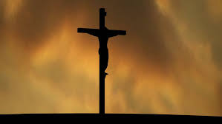
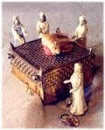
GOD HIMSELF (LAMBS BOOK)
ANGELS
7TH DIMENSION
THOUGHT (GENE OF GOD)
SAINTS BEYOND THE CURTAIN
IN THEOPHANIES.
6TH DIMENSION
WORD (THEOPHANY)
1ST DIMENSION….LIGHT
2ND DIMENSION…MATTER
3RD DIMENSION…TIME
4TH DIMENSION (book of life) & vision
RADIO, TELEVISION, ETHER WAVES
Spots of light is the elect
in the darkness of humanity.
Darkness shall cover the earth
and gross darkness the people
FLESH
PARADISE
BEFORE CALVARY.
SOULS OF THE UNJUST IN PRISON
FIFTH
DIMENSION
DEMONS
HELL
DEATH
GRAVE
SATAN HIMSELF & HELL
KEYS

Slide 24

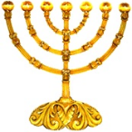
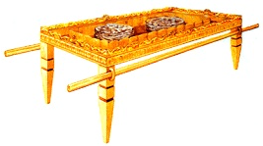

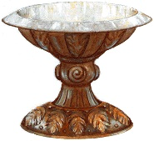
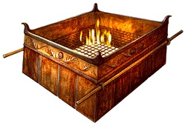
HOLY OF HOLIES
…THE ARK
…AND ITS MERCY SEAT
…WOOD OVERLAID WITH GOLD
7
6
HOLY PLACE
…7 GOLDEN CANDLESTICKS
…GOLDEN ALTAR OF INCENSE.
…TABLE OF SHEWBREAD.
3
5
4
OUTER COURT
…SEA OF GLASS OR BRONZE LAVER …BRAZEN ALTAR (sacrifice)
2
1

Slide 25
HOLY OF HOLIES
…THE BRIDE AGE… shout / voice / trumpet…
Those alive and remaining for a general gathering
for the wedding supper in 7th dimension
Bride of this day to be gathered
with Bride of all the ages.
HOLY PLACE
SAINTS BEYOND THE CURTAIN OF TIME… …gathered with the messenger of each age and
having a theophany body.
Redeemed Bride of all ages
that have died in Christ.
OUTER COURT
…REV 15…those who got victory over the beast.
…JEWISH SOULS under the altar (5TH SEAL)… unrobed…. Disembodied souls.
Sea of glass…foolish virgins
& 144000 Jewish saints.
Souls under the altar…Jews

Slide 26
SINCERE JEWS BLINDED FOR 7 CHURCH AGES AND KILLED FOR
BEING JEWS (ALSO IN WW2)
REVELATION 6:9
» 9 † ¶ And when he had opened the fifth seal, I saw under the altar the souls of them that were slain for the word of God, and for the testimony which they held:
» 10 † And they cried with a loud voice, saying, How long, O Lord, holy and true, dost thou not judge and avenge our blood on them that dwell on the earth?
» 11 † And white robes were given unto every one of them; and it was said unto them, that they should rest yet for a little season, until their fellowservants also and their brethren, that should be killed as they were, should be fulfilled.

Slide 27
ROMAN SPIRIT
REVELATION 9:15
» 15 † And the four angels were loosed, which were prepared for an hour, and a day, and a month, and a year, for to slay the third part of men.
» 16 † And the number of the army of the horsemen were two hundred thousand thousand: and I heard the number of them.
» 17 † And thus I saw the horses in the vision, and them that sat on them, having breastplates of fire, and of jacinth, and brimstone: and the heads of the horses were as the heads of lions; and out of their mouths issued fire and smoke and brimstone.
» 18 † By these three was the third part of men killed, by the fire, and by the smoke, and by the brimstone, which issued out of their mouths.
6 MILLION OUT OF 18 MILLION JEWS KILLED……. OVENS…….GAS….. BULLETS.

Slide 28
THE SEA OF GLASS IS THE SYMBOL OF THE LAVER
IN THE OUTER COURT.
REVELATION 15:1
» 1 † ¶ And I saw another sign in heaven, great and marvellous, seven angels having the seven last plagues; for in them is filled up the wrath of God.
» 2 † And I saw as it were a sea of glass mingled with fire: and them that had gotten the victory over the beast, and over his image, and over his mark, and over the number of his name, stand on the sea of glass, having the harps of God.
» 3 † And they sing the song of Moses the servant of God, and the song of the Lamb, saying, Great and marvellous are thy works, Lord God Almighty; just and true are thy ways, thou King of saints.

Slide 29
HOLY OF HOLIES
…THE WEDDING SUPPER TO COME…
a general gathering
Bride of this day gathered
with Bride of all the ages.
HOLY PLACE
SAINTS BEYOND THE CURTAIN OF TIME… …gathered with the messenger of each age.
Redeemed Bride of all ages
that have died in Christ.
OUTER COURT
…REV 15…those who got victory over the beast.
…JEWISH SOULS under the altar (5TH SEAL)… unrobed…. Disembodied souls.
Sea of glass…foolish virgins
& 144000 Jewish saints.
ALL IN
ONE
SIMILAR
PLACE
Souls under the altar…Jews

Slide 30
SEEDS AND BODIES

Slide 31
I CORINTHIANS 15:35
» 35 † ¶ But some man will say, How are the dead raised up? and with what body do they come?
» 36 † Thou fool, that which thou sowest is not quickened, except it die:
» 37 † And that which thou sowest, thou sowest not that body that shall be, but bare grain, it may chance of wheat, or of some other grain:
» 38 † But God giveth it a body as it hath pleased him, and to every seed his own body.

Slide 32
I CORINTHIANS 15:39
» 39 † All flesh is not the same flesh: but there is one kind of flesh of men, another flesh of beasts, another of fishes, and another of birds.
» 40 † There are also celestial bodies, and bodies terrestrial: but the glory of the celestial is one, and the glory of the terrestrial is another.
» 41 † There is one glory of the sun, and another glory of the moon, and another glory of the stars: for one star differeth from another star in glory.
» 42 † So also is the resurrection of the dead. It is sown in corruption; it is raised in incorruption:

Slide 33
SEEDS AND BODIES AND THEIR DESTINIES.
THE BRIDE HAS A SEED AND A BODY……………………………………….1ST RESURRECTION
FOOLISH VIRGIN HAS A SEED AND A BODY……………………………..2ND RESURRECTION
THE JEWS UNDER THE BRAZEN ALTAR IN THE 5TH SEAL…………...2ND RESURRECTION
THOSE THAT DO GOOD TO THE BRIDE IN MATTHEW 25………… 2ND RESURRECTION
THE 144,000 ELECT JEWS TYPING BENJAMIN…………..…GO INTO THE MILLENNIUM
THOSE THAT DO NOT WORSHIP THE BEAST…………………………… 2ND RESURRECTION
THOSE THAT YOU LOVE AND THOSE THAT LOVE YOU……….……. 2ND RESURRECTION
THOSE THAT NEVER HEARD THE GOSPEL………… RAISED UP FOR THE MILLENNIUM

