Slide 1
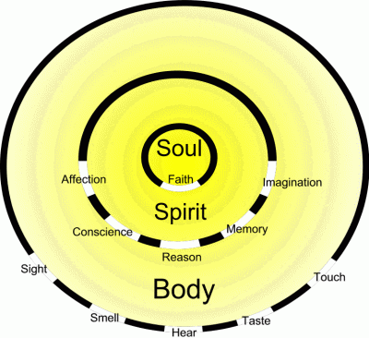

Slide 2
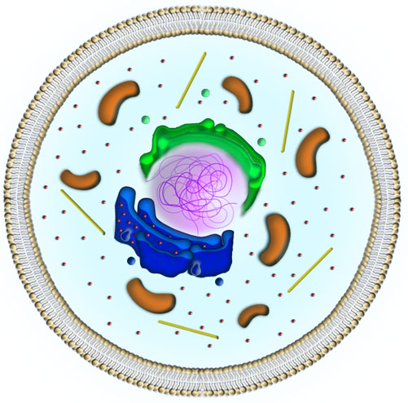
All living things are made up of Cells

Slide 3
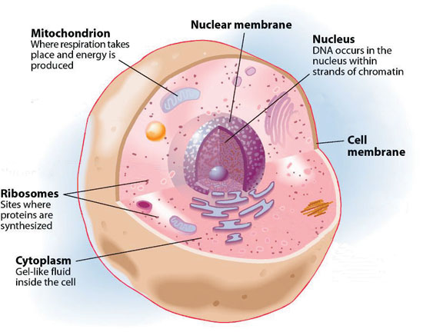

Slide 4
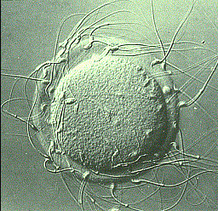
A Female egg cell surrounded with sperm from a male, this is for the purpose of fertilising the seed.

Slide 5
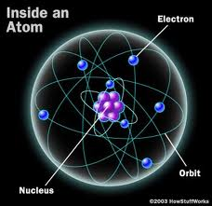
From the smallest – The Atom

Slide 6
To the Earth

Slide 7
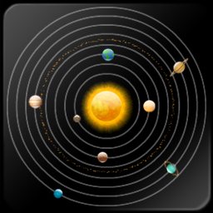
To our Solar System

Slide 8
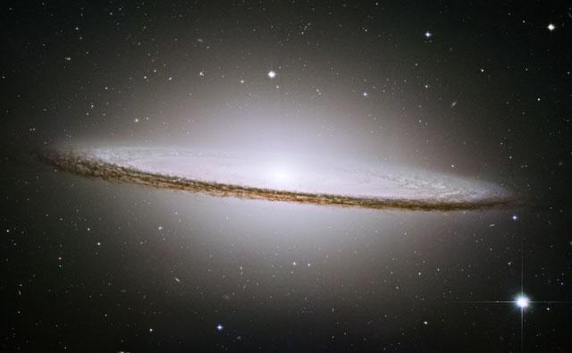
To a Galaxy

Slide 9
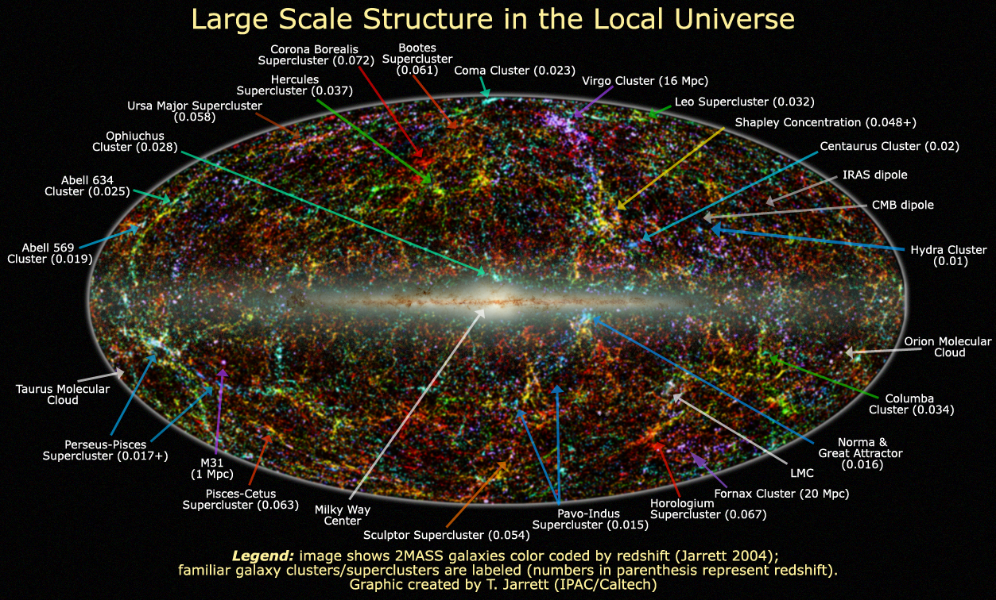
To The Local Universe

Slide 10
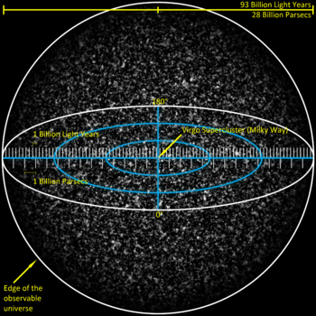
To The Entire Universe

Slide 11
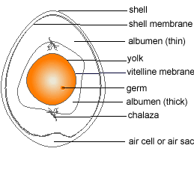
Back to an Egg

Slide 12
A Cartwheel

Slide 13
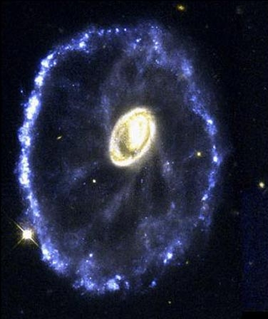
The Cartwheel Galaxy

